Slide 1


Since 2011
Our outcomes are over 5000 trainees.
Get IT Right from RIG

Slide 2

Full Stack Development
with
Pandas
Learn, Create, and Shine
Digital Space

Slide 3
Courses
• Building Your First Python GUI Application With Tkinter
• Working With Widgets
• Controlling Layout With Geometry Managers
• Making Your Applications Interactive

Slide 4
What is Pandas?
Pandas is a Python library used for working with data sets.
It has functions for analyzing, cleaning, exploring, and manipulating data.
The name "Pandas" has a reference to both "Panel Data", and "Python Data Analysis" and was created by Wes McKinney in 2008.

Slide 5
Why Use Pandas?
Pandas allows us to analyze big data and make conclusions based on statistical theories.
Pandas can clean messy data sets, and make them readable and relevant.
Relevant data is very important in data science.

Slide 6
What Can Pandas Do?
Is there a correlation between two or more columns?
What is average value?
Max value?
Min value?

Slide 7
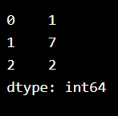
Pandas Series (col)
import pandas as pd
a = [1, 7, 2]
myvar = pd.Series(a)
print(myvar)

Slide 8
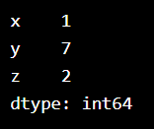
Create Labels
import pandas as pd
a = [1, 7, 2]
myvar = pd.Series(a, index = ["x", "y", "z"])
print(myvar)

Slide 9
Create Labels
import pandas as pd
a = [1, 7, 2]
myvar = pd.Series(a, index = ["x", "y", "z"])
print(myvar)

Slide 10
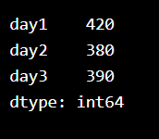
Key/Value Objects
import pandas as pd
calories = {"day1": 420, "day2": 380, "day3": 390}
myvar = pd.Series(calories)
print(myvar)

Slide 11
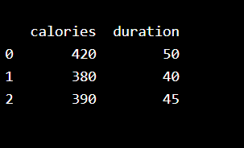
DataFrames
import pandas as pd
data = {
"calories": [420, 380, 390],
"duration": [50, 40, 45]
}
myvar = pd.DataFrame(data)
print(myvar)

Slide 12
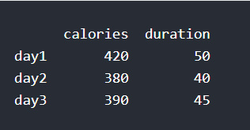
Named Indexes
import pandas as pd data = { "calories": [420, 380, 390], "duration": [50, 40, 45] } df = pd.DataFrame(data, index = ["day1", "day2", "day3"]) print(df)

Slide 13
Load Files Into a DataFrame
import pandas as pd
df = pd.read_csv('data.csv')
print(df)

Slide 14
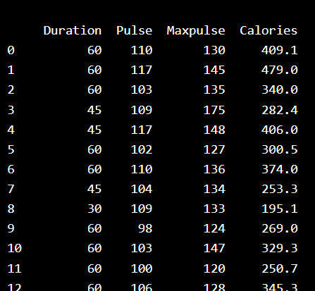
Read CSV Files
import pandas as pd df = pd.read_csv('data.csv') print(df.to_string())

Slide 15
Read JSON
import pandas as pd
df = pd.read_json('data.json')
print(df.to_string())

Slide 16
Pandas - Cleaning Data
Empty cells
Data in wrong format
Wrong data
Duplicates

Slide 17



Using Mean, Median, or Mode
Notes:
https://www.w3schools.com/python/pandas/pandas_cleaning_empty_cells.asp

Slide 18
Remove Rows
import pandas as pd
df = pd.read_csv('data.csv')
new_df = df.dropna()
print(new_df.to_string())

Slide 19
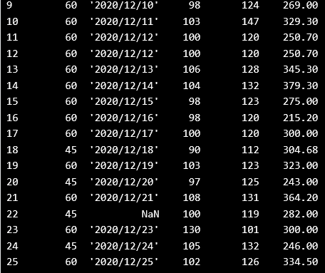
Mean
import pandas as pd
df = pd.read_csv('data.csv')
x = df["Calories"].mean()
df["Calories"].fillna(x, inplace = True)
print(df.to_string())
Mean = the average value (the sum of all values divided by number of values).
Notes:
#As you can see in row 18 and 28, the empty values from "Calories" was replaced with the mean: 304.68

Slide 20
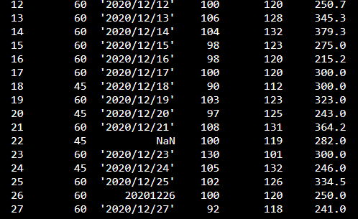
Median
import pandas as pd
df = pd.read_csv('data.csv')
x = df["Calories"].median()
df["Calories"].fillna(x, inplace = True)
print(df.to_string())
Median = the value in the middle, after you have sorted all values ascending.
Notes:
#As you can see in row 18 and 28, the empty values from "Calories" was replaced with the median: 291.2

Slide 21
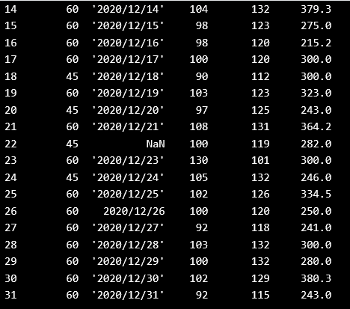
Mode
import pandas as pd
df = pd.read_csv('data.csv')
x = df["Calories"].mode()[0]
df["Calories"].fillna(x, inplace = True)
print(df.to_string())
Notes:
Duration,Date,Pulse,Maxpulse,Calories
60,'2020/12/01',110,130,409.1
60,'2020/12/02',117,145,479.0
60,'2020/12/03',103,135,340.0
45,'2020/12/04',109,175,282.4
45,'2020/12/05',117,148,406.0
60,'2020/12/06',102,127,300.0
60,'2020/12/07',110,136,374.0
450,'2020/12/08',104,134,253.3
30,'2020/12/09',109,133,195.1
60,'2020/12/10',98,124,269.0
60,'2020/12/11',103,147,329.3
60,'2020/12/12',100,120,250.7
60,'2020/12/12',100,120,250.7
60,'2020/12/13',106,128,345.3
60,'2020/12/14',104,132,379.3
60,'2020/12/15',98,123,275.0
60,'2020/12/16',98,120,215.2
60,'2020/12/17',100,120,300.0
45,'2020/12/18',90,112,
60,'2020/12/19',103,123,323.0
45,'2020/12/20',97,125,243.0
60,'2020/12/21',108,131,364.2
45,,100,119,282.0
60,'2020/12/23',130,101,300.0
45,'2020/12/24',105,132,246.0
60,'2020/12/25',102,126,334.5
60,20201226,100,120,250.0
60,'2020/12/27',92,118,241.0
60,'2020/12/28',103,132,
60,'2020/12/29',100,132,280.0
60,'2020/12/30',102,129,380.3
60,'2020/12/31',92,115,243.0

Slide 22
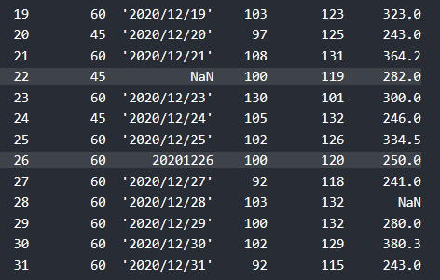
Data of Wrong Format
Cells with data of wrong format can make it difficult, or even impossible, to analyze data.
To fix it, you have two options: remove the rows, or convert all cells in the columns into the same format.

Slide 23
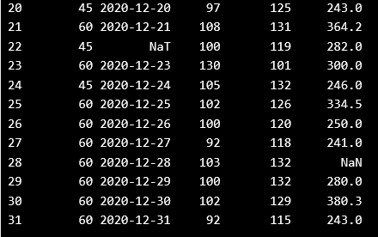
to_datetime()
import pandas as pd df = pd.read_csv('data.csv') df['Date'] = pd.to_datetime(df['Date']) print(df.to_string())

